Slide 1
Lecture 8
Recursion

Slide 2
Introduction
A repetitive algorithm is simply code that needs to be run over and over again.
In general, there are 2 approaches to writing repetitive algorithms:
Iteration
Recursion
We will define these 2 methods by use of an example.

Slide 3
Recursion
A recursive procedure is a procedure which calls itself.
A function that replicates itself again and again until the base case is not achieved.
Base Case
Values of the input variables for which we perform no recursive calls are called base cases (there should be at least one base case).
Every possible chain of recursive calls must eventually reach a base case.
Recursive
Calls to the current method.
Each recursive call should be defined so that it makes progress towards a base case.

Slide 4
Factorial
Let’s consider a function to calculate the factorial of a number.
For example, let’s determine the factorial of 4: factorial(4)=4 x 3 x 2 x 1 = 24

Slide 5
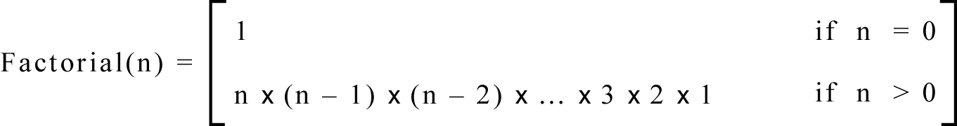
Iterative Definition
In general, we can define the factorial function in the following way:

Slide 6
Iterative Definition
This is an iterative definition of the factorial function.
It is iterative because the definition only contains the algorithm parameters and not the algorithm itself.
This will be easier to see after defining the recursive implementation.

Slide 7
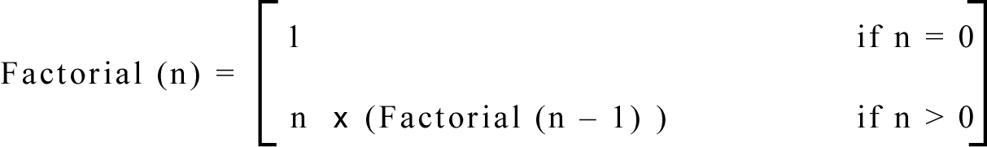
Recursive Definition
We can also define the factorial function in the following way:

Slide 8
Iterative vs. Recursive
Function does NOT call itself
Iterative
factorial(n) = 1 if n=0
n x (n-1) x (n-2) x … x 2 x 1 if n>0
Recursive
factorial(n) = 1 if n=0 n x factorial(n-1) if n>0
Function calls itself

Slide 9
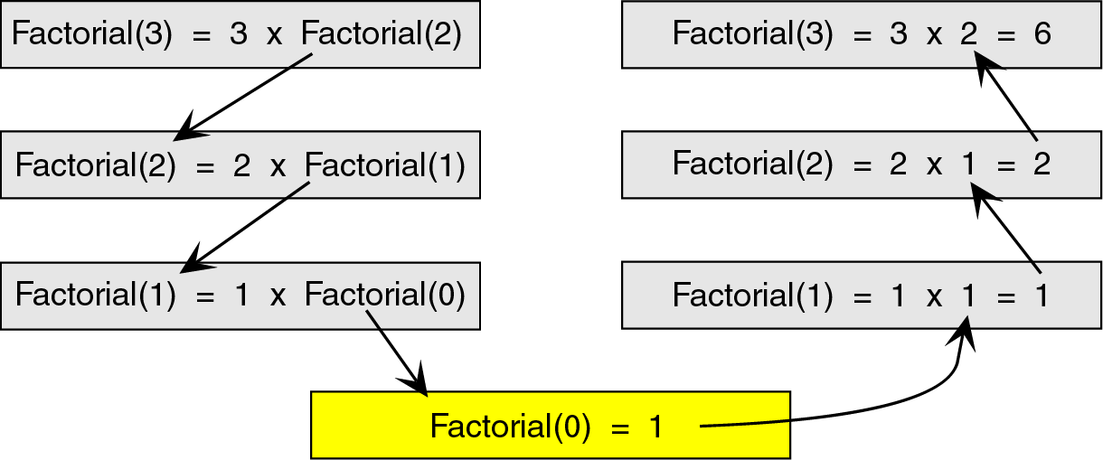
Recursion
To see how the recursion works, let’s break down the factorial function to solve factorial(3)

Slide 10
Breakdown
Here, we see that we start at the top level, factorial(3), and simplify the problem into 3 x factorial(2).
Now, we have a slightly less complicated problem in factorial(2), and we simplify this problem into 2 x factorial(1).

Slide 11
Breakdown
We continue this process until we are able to reach a problem that has a known solution.
In this case, that known solution is factorial(0) = 1.
The functions then return in reverse order to complete the solution.

Slide 12
Breakdown
This known solution is called the base case.
Every recursive algorithm must have a base case to simplify to.
Otherwise, the algorithm would run forever (or until the computer ran out of memory).

Slide 13
Breakdown
The other parts of the algorithm, excluding the base case, are known as the general case.
For example: 3 x factorial(2) ➔ general case 2 x factorial(1) ➔ general case etc …

Slide 14
Breakdown
After looking at both iterative and recursive methods, it appears that the recursive method is much longer and more difficult.
If that’s the case, then why would we ever use recursion?
It turns out that recursive techniques, although more complicated to solve by hand, are very simple and elegant to implement in a computer.

Slide 15
Iteration vs. Recursion
Now that we know the difference between an iterative algorithm and a recursive algorithm, we will develop both an iterative and a recursive algorithm to calculate the factorial of a number.
We will then compare the 2 algorithms.

Slide 16
Iterative Algorithm
factorial(n) {
i = 1
factN = 1
loop (i <= n)
factN = factN * i
i = i + 1
end loop
return factN
}
The iterative solution is very straightforward. We simply loop through all the integers between 1 and n and multiply them together.

Slide 17
Recursive Algorithm
Note how much simpler the code for the recursive version of the algorithm is as compared with the iterative version ➔
we have eliminated the loop and implemented the algorithm with 1 ‘if’ statement.
factorial(n) {
if (n = 0) return 1
else
return n*factorial(n-1)
end if
}

Slide 18
How Recursion Works
To truly understand how recursion works, we need to first explore how any function call works.
When a program calls a subroutine (function) the current function must suspend its processing.
The called function then takes over control of the program.

Slide 19
How Recursion Works
When the function is finished, it needs to return to the function that called it.
The calling function then ‘wakes up’ and continues processing.
One important point in this interaction is that, unless changed through call-by- reference, all local data in the calling module must remain unchanged.

Slide 20
How Recursion Works
Therefore, when a function is called, some information needs to be saved in order to return the calling module back to its original state (i.e., the state it was in before the call).
We need to save information such as the local variables and the spot in the code to return to after the called function is finished.

Slide 21
How Recursion Works
To do recursion we use a stack.
Before a function is called, all relevant data is stored in a stackframe.
This stackframe is then pushed onto the system stack.
After the called function is finished, it simply pops the system stack to return to the original state.

Slide 22
How Recursion Works
By using a stack, we can have functions call other functions, which can call other functions, etc.
Because the stack is a first-in, last-out data structure, as the stackframes are popped, the data comes out in the correct order.

Slide 23
Designing Recursive Algorithms
We first note that all recursive algorithms have 2 parts:
A part that solves one part of the problem
A part that reduces the size of the problem
Every call to a recursive algorithm must either solve a part of the problem (base case) or reduce it in size (general case).

Slide 24
Designing Recursive Algorithms
Design rules:
Determine the base case.
Determine the general case.
Combine the base case and the general case into an algorithm.
When combining the 2 parts of the algorithm, we must make sure that we either reduce the size of the problem (i.e., move it closer to the base case) or reach the base case.

Slide 25
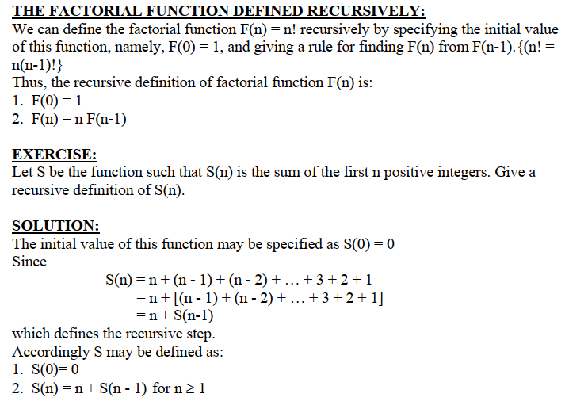

Slide 26
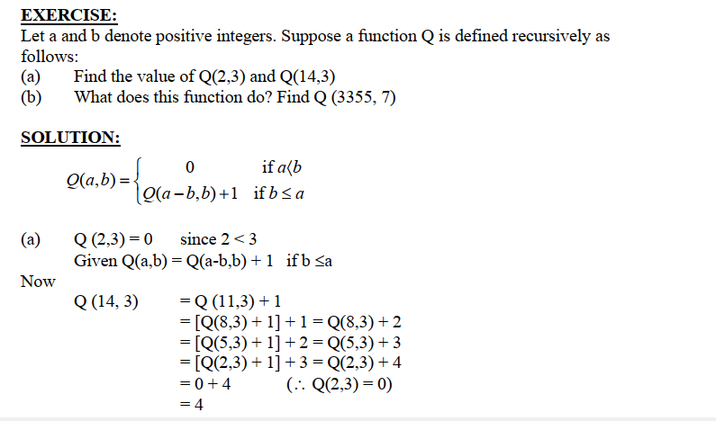

Slide 27
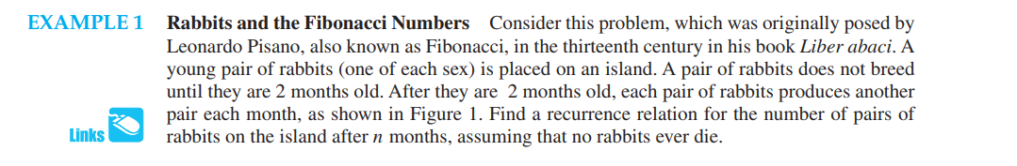
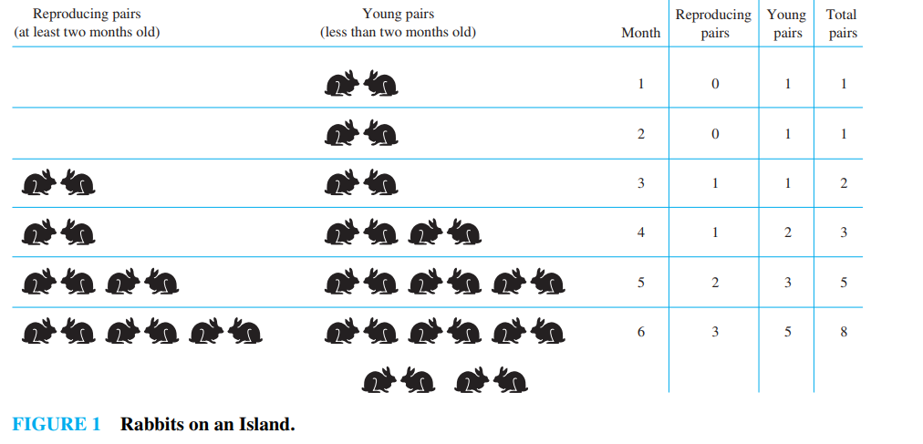

Slide 28
Example-Fibonanci series
Fibonnacci Sequence
0, 1, 1, 2, 3, 5, 8, 13, 21, 34, . . . . . . . .
Each element is the sum of the two preceding elements with
fib(0) = 0
fib(1) = 1
fib(n) = n if n ==0 or n ==1
fib(n) = fib(n-2) + fib(n-1) if n >= 2

Slide 29
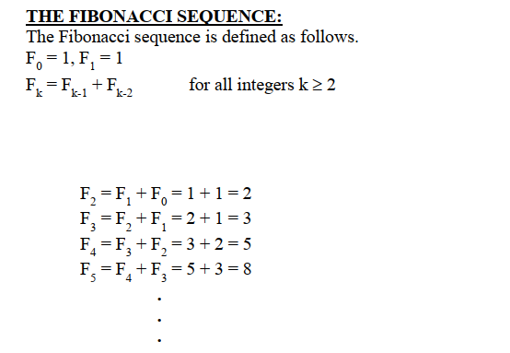

Slide 30
Fibonacci Sequence (recursive definition )
Fib(n)
if(n<2)
return n
else
return Fib(n-1)+Fib(n-2)
T(n)=Θ(1.618^{n})

Slide 31
Recursive Programming
Fibonnacci Sequence
fib(n) = n if n ==0 or n ==1
fib(n) = fib(n-2) + fib(n-1) if n >= 2
int fib(int n)
{
if(n == 0 || n == 1)
return n;
else
return fib(n-2) + fib(n-1)
}

Slide 32
Problem To Be Solved
Fib(5)
Fib(3)
Fib(4)
Fib(1)
Fib(2)
Fib(2)
Fib(3)
Fib(2)
Fib(1)
Fib(0)
Fib(1)
Fib(0)
Fib(1)
Fib(0)
Fib(1)

Slide 33
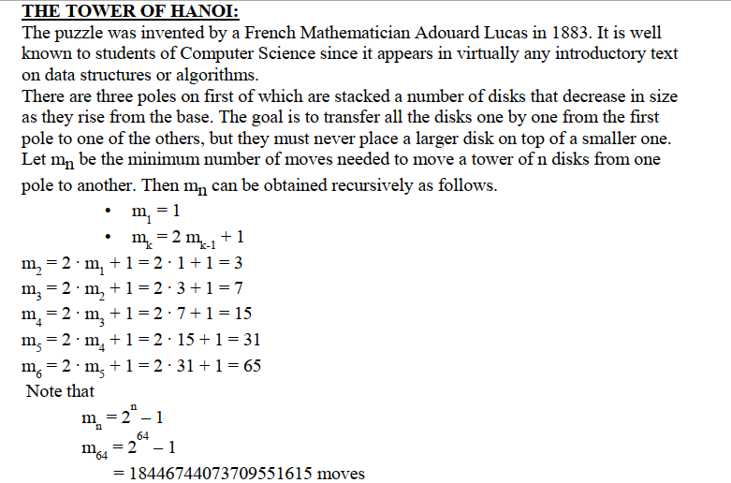

Slide 34
Example – Find
To find an element in an array
Base case
If array is empty, return false
Recursive step
If 1st element of array is given value, return true
Skip 1st element and recur on remainder of array

Slide 35
Example – Count
To count # of elements in an array
Base case
If array is empty, return 0
Recursive step
Skip 1st element and recur on remainder of array
Add 1 to result

Slide 36
Advantages of Recursion
Recursion is a powerful problem-solving technique that often produces very clean solutions to even the most complex problems.
Recursive solutions can be easier to understand and to describe than iterative solutions.

Slide 37
Limitations of Recursion
By using recursion, you can often write simple, short implementations of your solution.
However, just because an algorithm can be implemented in a recursive manner doesn’t mean that it should be implemented in a recursive manner.

Slide 38
Limitations of Recursion
Recursion works the best when the algorithm and/or data structure that is used naturally supports recursion.
One such data structure is the tree (more to come).
One such algorithm is the binary search algorithm.

Slide 39
Limitations of Recursion
Recursive solutions may involve extensive overhead because they use calls.
When a call is made, it takes time to build a stackframe and push it onto the system stack.
Conversely, when a return is executed, the stackframe must be popped from the stack and the local variables reset to their previous values – this also takes time.

Slide 40
Conclusion
A recursive solution solves a problem by solving a smaller instance of the same problem.
It solves this new problem by solving an even smaller instance of the same problem.
Eventually, the new problem will be so small that its solution will be either obvious or known.
This solution will lead to the solution of the original problem.

Slide 41
Conclusion
4 questions for constructing recursive solutions:
How can you define the problem in terms of a smaller problem of the same type?
How does each recursive call diminish the size of the problem?
What instance of the problem can serve as the base case?
As the problem size diminishes, will you reach the base case?

Slide 42
Conclusion
In general, there is no reason to incur the overhead of recursion when its use does not gain anything.
Recursion is truly valuable when a problem has no simple iterative solution.

Slide 43
Paper Pattern
Objective (50 %)
MCQs
Subjective (50%)

Slide 44
Topics in the Mid Exam
Basic concepts and mathematical foundation
Algorithm definition and importance in CS
Analyzing Algorithm
Algorithm Complexity
Growth of functions
Asymptotic Notations
List Data Structure
Single Linked List
Circular Linked List
Doubly Linked List

Slide 45
Topics in the Mid Exam
Stack
Applications
Queue
Enqueue and Dequeue
Circular Queue
Recursion
Tower of Hanoi
Factorial
Fibonacci series

